Slide 1
How I saved the World with Dailyclean, an open-sourced tool developed in Quarkus
Guillaume THOMAS
31/01/2023
Notes:
WARNING: if you try to copy/paste slides from the former PPT version / layout you will probably face some technical issues. To avoid this, click on ‘new slide’ in the top menu and copy/paste the elements from your former slide onto the new one (do not copy/paste the slide itself).

Slide 2
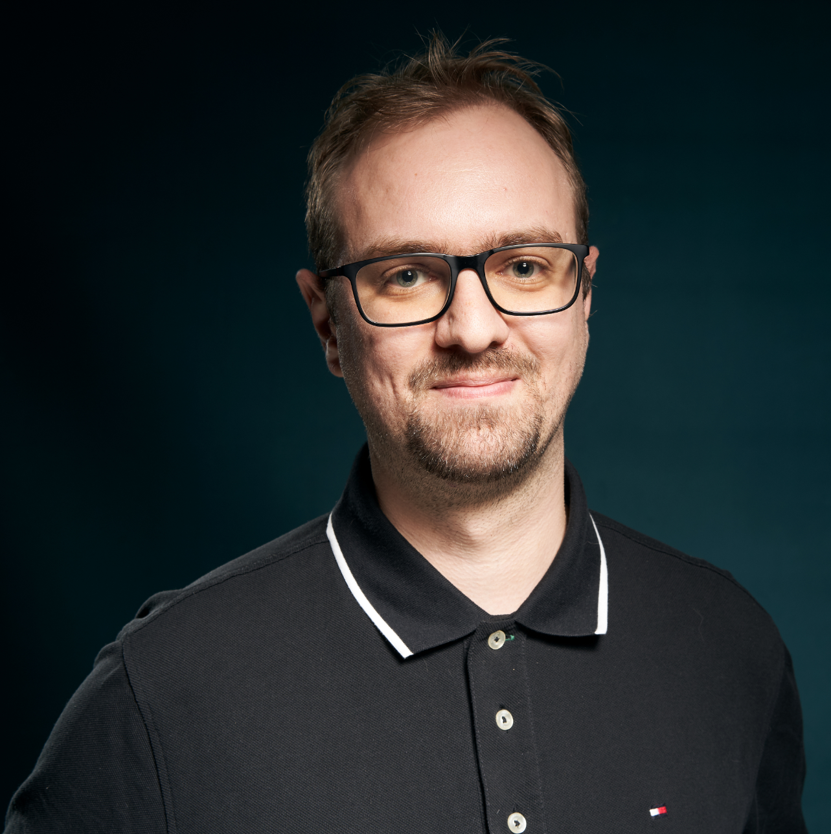



Guillaume THOMAS
ML Engineer @AXAFR

Slide 3

What is the Dailyclean project ?
Dailyclean is an open-sourced tool by AXA France
Saves your resources by turning on and off your Kubernetes namespaces
Planified or on demand
It works with all the Kubernetes distributions
Good for your GreenIT and Finops objectives
Mandatory at AXA France
Based on Quarkus and GraalVM
Notes:
To change bullet colors, select the text and go to the HOME menu > Bullets and numbers > choose a bullet and select a color from the color palette

Slide 4

Contents
How I saved the World with Dailyclean, an open-sourced tool developed in Quarkus | 31/01/2023
1. Overview demonstration P. 05
2. Why did AXA develop it? P. 06
3. How is it working? P. 15
4. Why Quarkus & GraalVM? P. 18
5. To conclude P. 26
Notes:
Page numbers are flushed right using the tab function ("->” key or "TAB" key), and are formatted manually.
Chapters are now numbered automatically.
To edit the footer for the entire document, go to INSERT > Header and footer, and fill in the desired titles and dates.
The vertical line should be adjusted manually.

Slide 5
1
Overview demonstration
Notes:
The background color can be changed using the slide’s background color commands. Only use approved AXA colors.

Slide 6
2
Why did AXA develop it?
Notes:
The background color can be changed using the slide’s background color commands. Only use approved AXA colors.

Slide 7

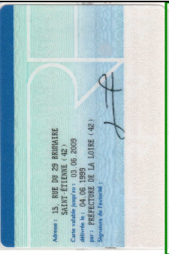

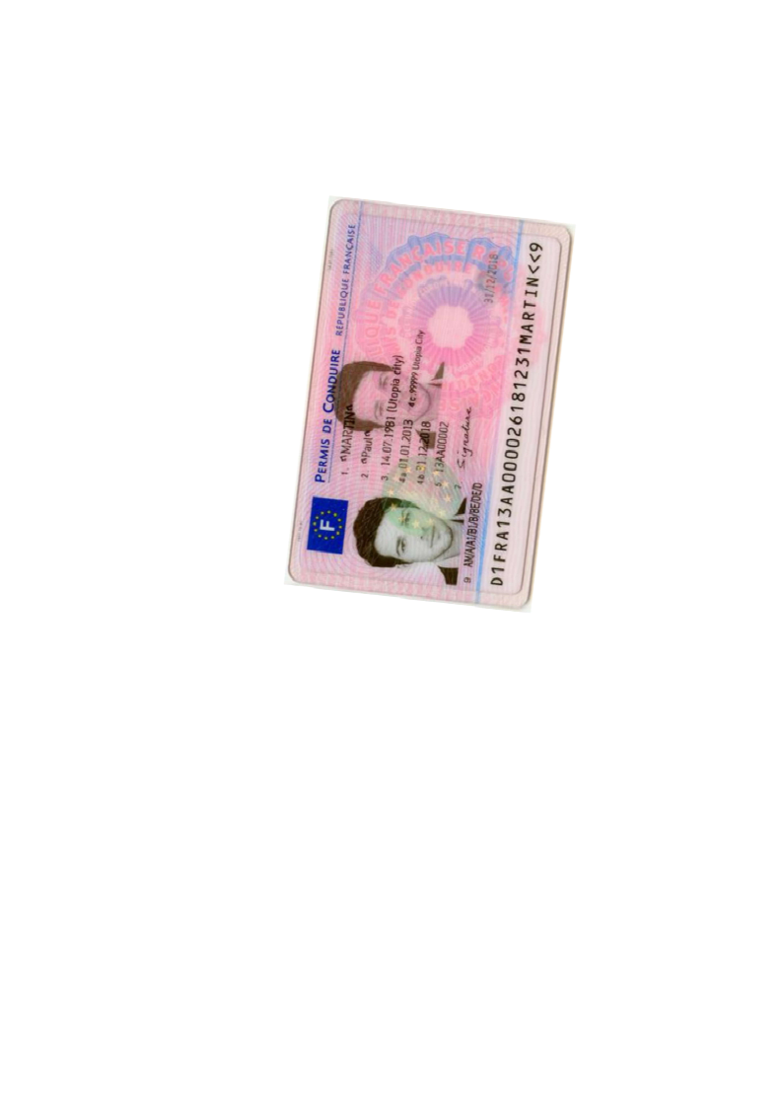
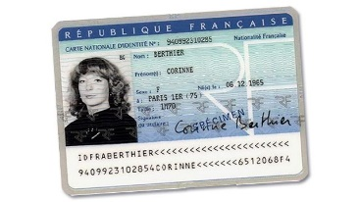


Page
Zoning
Homography
Zoning
OCR
Split
Split
Zoning
Homography
Zoning
OCR

Slide 8
What do we need to run complex ML solutions?
To sum up
Microservices
Each one may need a different version of Python
We often need to install specific librairies on the OS
Using containers is a consistent solution to meet our needs!

Slide 9



Containers technologies chosen by AXA

Slide 10
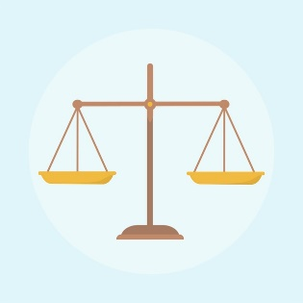

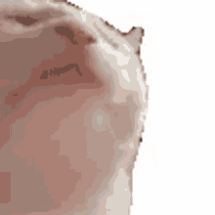
Finops learning leading us to Dailyclean
RAM
$
÷ 10
$
XX XXX $ / month
X XXX $ / month

Slide 11
Balancing availability and actual needs
Global observations at AXA for our IT projects. Have you ever noticed?
Usually, we let our applications up:
24 hours per day | 7 days per week | 12 months per year
BUT, often, we only need our applications to be up only:
12 hours per day
SO, in that case, our applications are NOT used:
12 hours per day
| 60 hours per week
| 240 hours per months
| 4,5 days per week
| 7 months per year
67 %

Slide 12


Slide 13
3
How is it working?
Notes:
The background color can be changed using the slide’s background color commands. Only use approved AXA colors.

Slide 14

Demo synthesis
creates
executes
CronJob
Job
schedule = 0 9 * * *

Slide 15




Demo synthesis
KUBERNETES API
CronJob start
Job start
Replicas = 1
DailycleanAPI
Replicas = 0
Job stop
CronJob stop
Job start
Replicas = 1
DailycleanFront
Job stop
Replicas = 0

Slide 16
4
Why Quarkus & GraalVM?
Notes:
The background color can be changed using the slide’s background color commands. Only use approved AXA colors.

Slide 17
Our needs
Easy to develop
Easy to maintain
Less memory footprint as possible

Slide 18

What about Go?

Slide 19



I know

Slide 20

The choice of GraalVM
Ahead-of-time compilation
.JAR
=> .EXE
Fast startup & low memory footprint

Slide 21
The choice of Quarkus
Work with GraalVM native images OOB
Support by RedHat

Slide 22
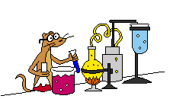

Benefits illustration
And now… a little experiment!

Slide 23

Prepare to be Amazed!

Slide 24
5
To conclude
Notes:
The background color can be changed using the slide’s background color commands. Only use approved AXA colors.

Slide 25
Conclusion
Often, applications could be shut off at least 67% of the time
Dailyclean can help you to keep your resources comsuption under control
It is good for your wallet
It is good for the Planet
Work with all you Kubernetes / OpenShift projects
And…

Slide 26

Dailyclean is open-source
https://github.com/AxaGuilDEv/dailyclean
Notes:
Other images with the Hero Switch can be found on the Brand Hub.
You can filter using : Brand Assets > Photography > Hero Switch Photography.

Slide 27
Do you have some questions?
guillaume.thomas@axa.fr
@gthomasIT

Slide 28
Thank you

